Slide 1
Life Cycle Assessment applied to Carbon Dioxide Removal processes: a literature review
Francesco Pietro Campo^{1*}, Lucia Rigamonti¹
¹ Politecnico di Milano, Dipartimento di Ingegneria Civile e Ambientale
*francescopietro.campo@polimi.it

Slide 2
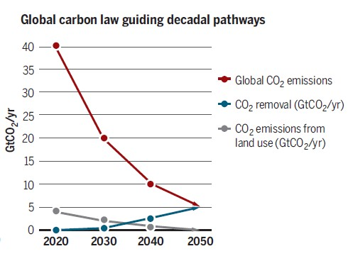
Carbon dioxide removal (CDR) processes
CDR processes under study:
Afforestation; Biochar; Soil Carbon Sequestration;
Bio-Energy with Carbon Capture and Storage (BECCS)
Direct Air Capture and Carbon Storage (DACCS)
Enhanced Weathering (EW)
CO₂ storage
Air
(N₂, O₂, CO₂…)
CO₂ storage
5 GtCO₂/year to be removed by 2050 according to Paris Agreement temperature goal
Source: Rockstrom et al., 2017
Basaltic rocks;
Calcium material

Slide 3
Literature review
Bibliographic database: Scopus
Keywords: Life Cycle Assessment + CDR full name
2 Bio-Energy with Carbon Capture and Storage (BECCS)
+ 2 Direct Air Capture and Carbon Storage (DACCS)
+ 1 Enhanced Weathering (EW)
= 5 assessed LCA
Common features:
System boundaries including CO₂ storage
LCIA method: GWP 100

Slide 4
Recommendations
Functional Unit: 1 kg CO₂ removed → to assess CDR Efficiency
System boundaries should include CO₂ storage
BECCS, LCI including C loss due to land use change
In addition to GW, other impact categories should be considered

Slide 5
Grazie per l’attenzione!
Francesco Pietro campo
francescopietro.campo@polimi.it

